Slide 1
Spatial Autocorrelation
Slides based to a large extent on the GeoDa Workbook by Luc Anselin
http://www.csiss.org/clearinghouse/GeoDa/geodaworkbook.pdf

Slide 2
Some Cool Data Sources
Census/American Community Survey
www.census.gov
RefUSA
http://www.referenceusa.com/
Bradstreet & Dun
Part of ArcGIS business analyst
PASDA
http://www.pasda.psu.edu/
Open Data Philly
https://www.opendataphilly.org/dataset

Slide 3
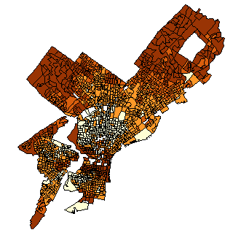

First Law of Geography
“Everything is related to everything else, but near things are more related than distant things.”
Waldo Tobler (1970)
This is the basic premise behind all of spatial stats
Median House Values (Census Block Group Level)
Waldo Tobler
…Darker colors -> Higher values…
Reference: TOBLER, W. R. (1970). "A computer movie simulating urban growth in the Detroit region". Economic Geography, 46(2): 234-240.

Slide 4

Spatial Autocorrelation (SA)
Negative SA
Similar to correlation, but…
Instead of examining the association between two variables, we look at the relationship of values within a single variable at nearby locations
There is said to be (positive) spatial autocorrelation in a variable if observations that are closer to each other in space have related values (i.e., recall Tobler’s Law)
There is said to be negative spatial autocorrelation in a variable if observations that are closer to each other have markedly different values (e.g., repulsion)
Happens fairly rarely. We’ll focus on positive SA
Concept of spatial autocorrelation stems from temporal autocorrelation – i.e., values of a variable at points close in time will be related
Examples?

Slide 5
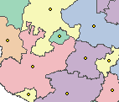
But How is Spatial Proximity Defined?
First of all, assume we’re dealing with areal data (polygons)
You can use the methods described here for point data as well, but contiguity-based measures of proximity don’t apply in those instances.
For each polygon, we need to identify its spatial relationship with all the other polygons.
Distance-based Measures of Proximity:
Are polygon centroids* within a certain distance of each other (1=yes, 0=no)?
Judging by distances between centroids, is polygon A one of the ___ (1, 2, 3, etc) nearest neighbors of polygon B (1=yes, 0=no)?
Contiguity-based Measures of Proximity:
Do polygons share a boundary with each other? (1=yes, 0=no)?
* The centroid of a polygon is its center of gravity (means of x and y coords)

Slide 6
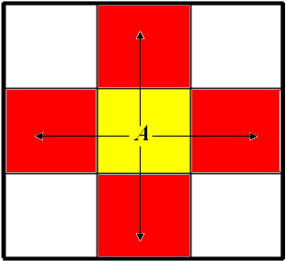
Rook Neighbor (for Areal Data)
Think the rook in chess: Moves up, down, left and right
When you’re not dealing with a regular lattice, a rook neighbor is one that shares a boundary segment with you.
Tract A and the red tracts share a boundary segment -> Rook Neighbors
Tract A and the white tracts intersect at a point (vertex) -> NOT Rook Neighbors
Rook Neighbors of tract A are those shaded in red
Questions:
Why are the white tracts not rook neighbors of tract A?
Which tracts are the Rook Neighbors of tract B?
B
See http://www.biomedware.com/software/Atlas_WebHelp/data/adj/Polygon_contiguities.htm

Slide 7
Queen Neighbor (for Areal Data)
Think the queen in chess: Moves up, down, left, right, and diagonally
When you’re not dealing with a regular lattice, a queen neighbor is one that intersects you either at a point (i.e., vertex) or a segment
What are some problems with queen/rook contiguity?
Queen Neighbors of tract A are both those shaded in red AND those shaded in white

Slide 8
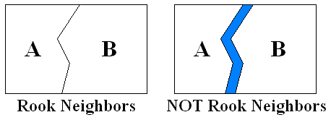
Problems with Queen/Rook Contiguity
On some maps, the river below may appear, on others it may not -> Arbitrary!
RIVER RIVER

Slide 9
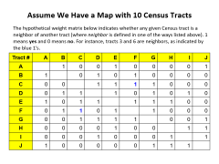
Weight Matrices
When we have n observations, we form an n x n table (called a weight matrix or a link matrix) which summarizes all the pairwise spatial relationships in the dataset
These weight matrices are used in the estimation of spatial regression (and the calculation of spatial autocorrelation indices)

Slide 10
Assume We Have a Map with 10 Census Tracts
The hypothetical weight matrix below indicates whether any given Census tract is a neighbor of another tract (where neighbor is defined in one of the ways listed above). 1 means yes and 0 means no. For instance, tracts 3 and 6 are neighbors, as indicated by the blue 1’s.
Tract # | A | B | C | D | E | F | G | H | I | J
A |  | 1 | 0 | 0 | 1 | 0 | 0 | 0 | 0 | 1
B | 1 |  | 0 | 1 | 0 | 1 | 0 | 0 | 0 | 0
C | 0 | 0 |  | 1 | 1 | 1 | 1 | 0 | 0 | 0
D | 0 | 1 | 1 |  | 1 | 0 | 1 | 0 | 1 | 0
E | 1 | 0 | 1 | 1 |  | 1 | 1 | 1 | 0 | 0
F | 0 | 1 | 1 | 0 | 1 |  | 1 | 0 | 0 | 0
G | 0 | 0 | 1 | 1 | 1 | 1 |  | 0 | 0 | 1
H | 0 | 0 | 0 | 0 | 1 | 0 | 0 |  | 1 | 1
I | 0 | 0 | 0 | 1 | 0 | 0 | 0 | 1 |  | 1
J | 1 | 0 | 0 | 0 | 0 | 0 | 1 | 1 | 1

Slide 11
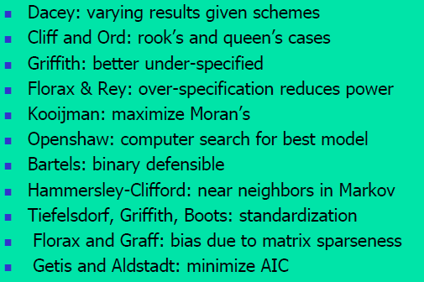
Picking a Weight Matrix
Source: Presentation by Art Getis at UCSB, Summer 2008
Unless you have strong theoretical motivations to not do so, it’s typically good to try several different weight matrices to make sure that your results are not merely an artifact of the matrix you’re using

Slide 12
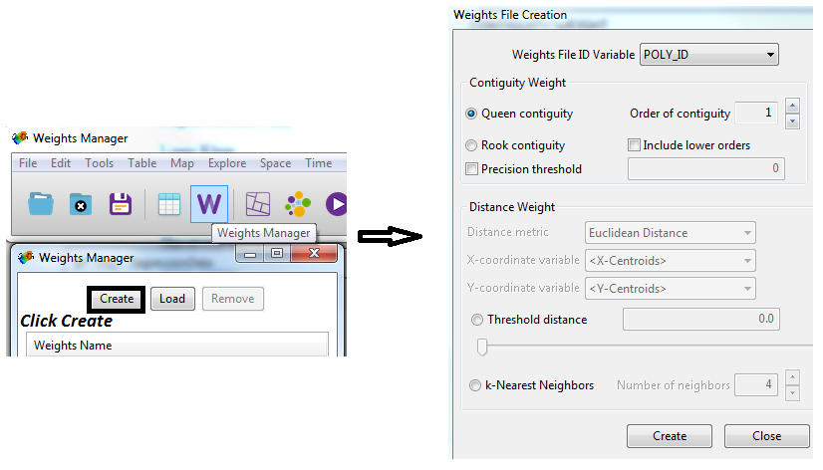
Creating Weight Matrices In GeoDa…
Save weight matrices as .gal or .gwt files
Use Projected Coordinate Systems!

Slide 13
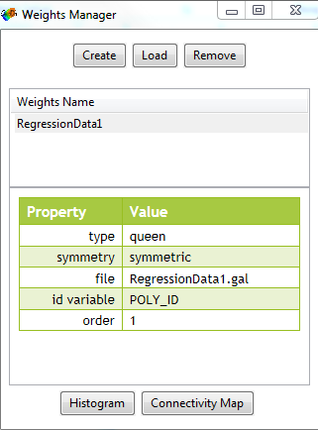
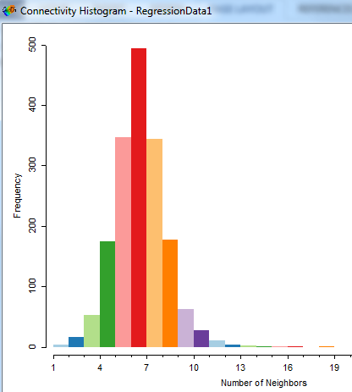
Connectivity Histogram for Rook/Queen Neighbors
Watch out for:
-- Bimodality
-- Islands

Slide 14
But How Do We Know if Spatial Dependencies Exist?
Moran’s I (1950) – a rather old and probably the most widely used method of testing for spatial autocorrelation, or spatial dependencies
Large positive values (close to 1) indicate that there is strong (positive) autocorrelation (i.e., similar values tend to cluster together)
Large negative values (close to -1) indicate that there is strong negative autocorrelation (i.e., areas with similar values of a variable tend to repel each other; dispersion)
Values around 0 indicate that there is no spatial autocorrelation (random pattern)
Under the independence hypothesis, Moran’s I has a mean that is slightly negative
E(I) = -1/(n-1)
Unlike the Pearson correlation coefficient, Moran’s I is not always between -1 and 1
Other indices of spatial autocorrelation commonly used include:
Geary’s c (1954)
Getis and Ord’s G-statistic (1992)
Moran’s I is calculated somewhat strangely in ArcGIS

Slide 15
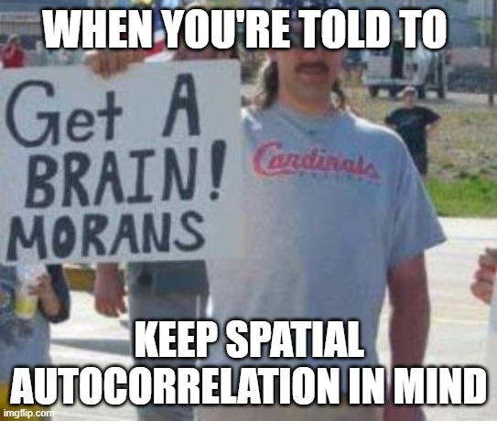

Slide 16
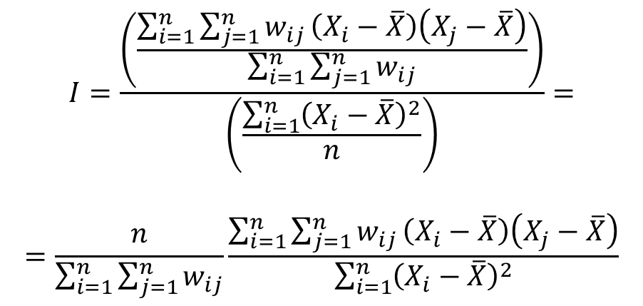
Moran’s I – Defined Mathematically
$$I=\frac{\left(\frac{\sum_{i=1}^{n}{\sum_{j=1}^{n}{w_{ij}}\left(X_{i}−\overline{X}\right)\left(X_{j}−\overline{X}\right)}}{\sum_{i=1}^{n}{\sum_{j=1}^{n}{w_{ij}}}}\right)}{\left(\frac{\sum_{i=1}^{n}{{\left(X_{i}−\overline{X}\right)}^{2}}}{n}\right)}=$$
$$=\frac{n}{\sum_{i=1}^{n}{\sum_{j=1}^{n}{w_{ij}}}}\frac{\sum_{i=1}^{n}{\sum_{j=1}^{n}{w_{ij}}\left(X_{i}−\overline{X}\right)\left(X_{j}−\overline{X}\right)}}{\sum_{i=1}^{n}{{\left(X_{i}−\overline{X}\right)}^{2}}}$$
where
X is the mean of the variable X
X_{i} is the variable value at a particular location i
X_{j} is the variable value at another location j
W_{ij} is a weight indexing location of i relative to j
n is the number of observations (points or areal units)
See http://www.spatialanalysisonline.com/HTML/index.html?global_spatial_autocorrelation.htm for an excellent discussion of what this formula means.
Also see the document Lecture 10 - Moran's I Formula Unpacked.docx on Canvas
Notes:
Can be interpreted roughly as covariance of the variable values at nearby locations standardized by the variance of the variable

Slide 17
Correlation Coefficient
=
Spatial
auto-correlation
Note: Slide shamelessly stolen from Dr. Ron Briggs (UT Dallas)

Slide 18
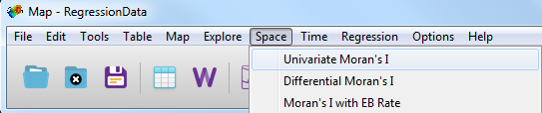
Moran’s I for Median House Price
Moran’s I for the Data… (~0.68 with Queen Matrix)
In GeoDa…
For more details, see http://www.csiss.org/clearinghouse/GeoDa/geodaworkbook.pdf

Slide 19
Significance Testing – Moran’s I
Is Moran’s I value of 0.68 high?
I.e., is this value higher than what we would observe under the null hypothesis of NO SPATIAL AUTOCORRELATION (i.e., spatial randomness)?
Recall that if there is no spatial autocorrelation, Moran’s I is close to 0 (slightly negative)
H0: No spatial autocorrelation
Ha1: Positive spatial autocorrelation
Ha2: Negative spatial autocorrelation

Slide 20
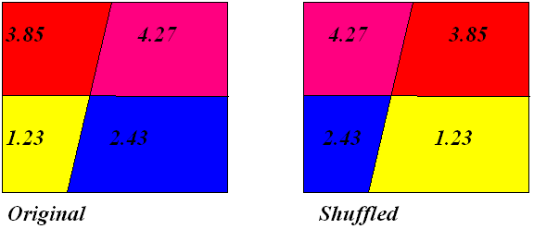
Steps
Compute Moran’s I for our original House Price variable
Randomly shuffle (permute) the values of the House Price variable
Calculate Moran’s I for this shuffled map
Repeat the shuffling process a total of 999 times, and calculate Moran’s I for each new permutation (shuffle)
Put all the 1000 Moran’s I values (one for original variable and 999 for random permutations) in descending order
See where the Moran’s I value for the (observed) House Price variable stands compared to the Moran’s I values for the random permutations (e.g., is it fifth highest, 322nd highest, etc).

Slide 21
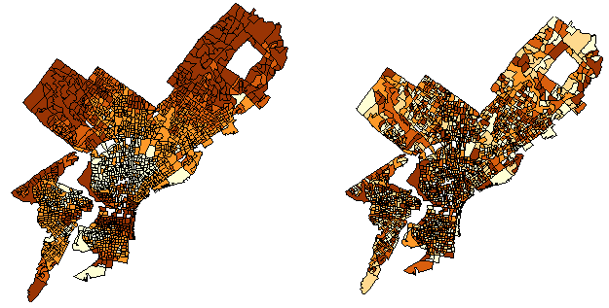
Random Shuffling
House Price (Observed) Random Shuffling of House Price Values
Moran’s I = 0.68
Moran’s I = 0.03
…Repeat this shuffling a total of 999 times & Calculate Moran’s I for each shuffle…

Slide 22
Steps (Cont’d)
Moran’s I values for the actual variable and the 999 permutations sorted in descending* order…
We see that the Moran’s I for the House Price is higher than the Moran’s I for all 999 random permutations.
H0: Moran’s I of our variable comes from the sampling distribution of Moran’s I for random zone relabelings. That is, there is no spatial autocorrelation.
Pseudo P-value: Chance of getting a value as large as the observed value using samples from this distribution
Pseudo P-value is calculated by taking the rank of Moran’s I and dividing it by 1000
So, here, the p-value is rank/1000 = 1/1000 = 0.001.
This means that there is (at most) a one-in-a-thousand chance of observing a Moran’s I of 0.68 if in fact there is no spatial autocorrelation present!
Here we have a value of Moran’s I (0.68) that is statistically significantly (since 0.001<0.05) different from 0.
SIGNIFICANT SPATIAL AUTOCORRELATION! -> Reject Null Hypothesis of NO SPATIAL AUTOCORRELATION!
* You would sort in ascending order if your Moran’s I is negative

Slide 23
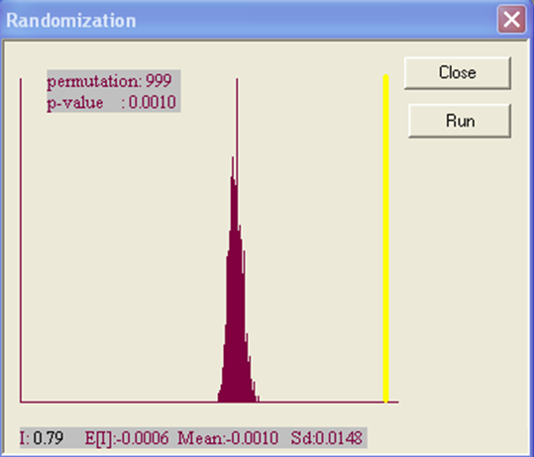
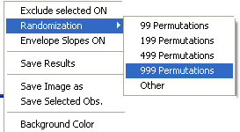
In GeoDa
-0.001 0.68
Mean & Standard Deviation of the Moran’s I values for the 999 random shuffles

Slide 24
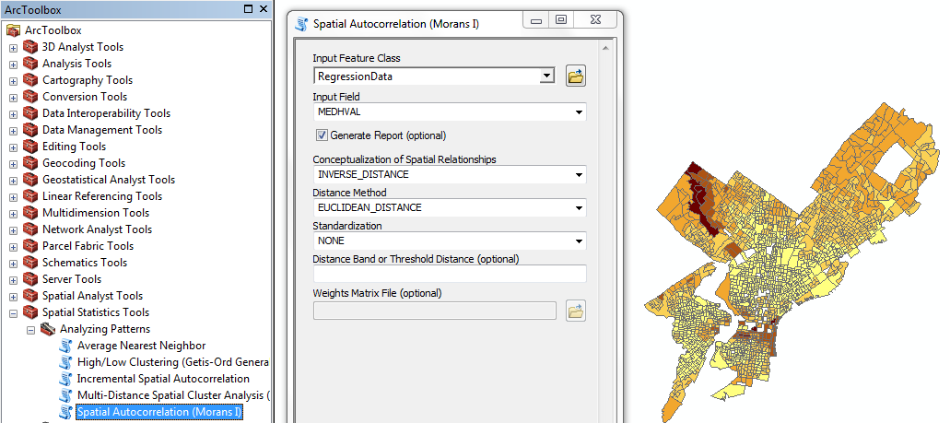
Moran’s I in ArcGIS
Uses Euclidean distance (block groups whose centroids are closer have higher weights), but does allow for specifying a weight matrix

Slide 25


Slide 26

Arc

Slide 27
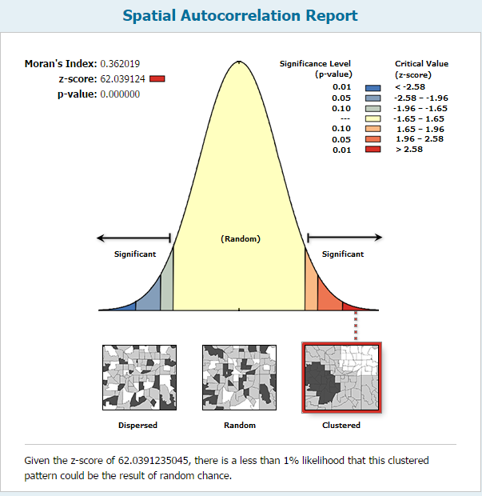
Output

Slide 28
Test Statistic for Normal Frequency Distribution
2.5%
2.5%
1%
Reject null
-1.96
0
1.96
2.54
Reject null at 5%
Null Hypothesis: no spatial autocorrelation
---Moran’s I = –1/(n-1)
Alternative Hypothesis: spatial autocorrelation exists
---Moran’s I > –1/(n-1)
Reject Null Hypothesis if Z test statistic > 1.96 (or < -1.96)
--- less than a 5% chance that, in the population, there is no
spatial autocorrelation
---95% confident that spatial autocorrelation exits
Note: Slide edited from a presentation by Dr. Ron Briggs (UT Dallas)
Reject null at 1%

Slide 29
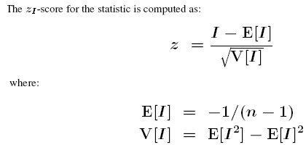
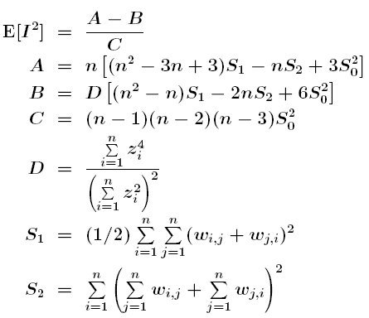
Mathematically Speaking…
Recall that the square root of the variance V is the standard deviation. So as with many other hypothesis tests, we’re taking the Moran’s I value in our dataset, subtracting from it its expected value, and dividing the difference by the standard deviation. This produces a standard normal random variable z.
*
*
Source: http://help.arcgis.com/en/arcgisdesktop/10.0/help/index.html#//005p0000000t000000

Slide 30
Problems With Procedure Above
Needs a sufficiently large number of observations (n>30), as per Central Limit Theorem
Another assumption is that each observation not have too many neighbors (i.e., weight matrix should be relatively sparse)
See Tiefelsdorf (2000, Section 9.4.1), Anselin and Rey (1991) and Anselin and Florax (1995).
These limitations are why random permutations tests, such as the ones available in GeoDA, are generally preferred by statisticians.

Slide 31
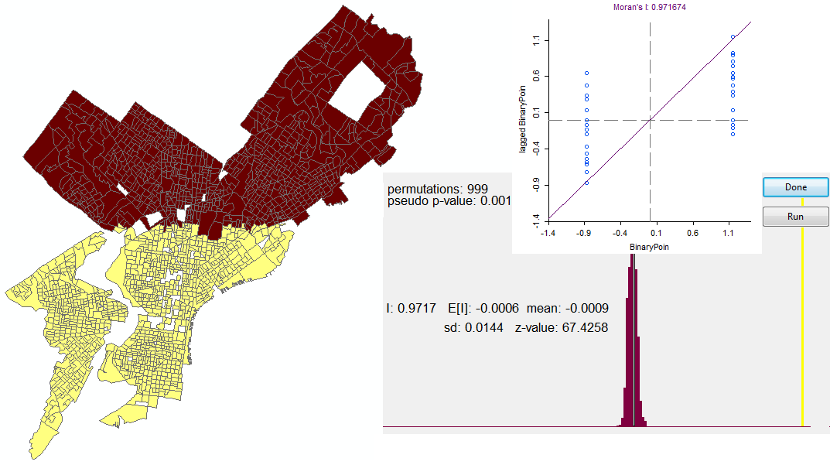
Weird Patterns

Slide 32
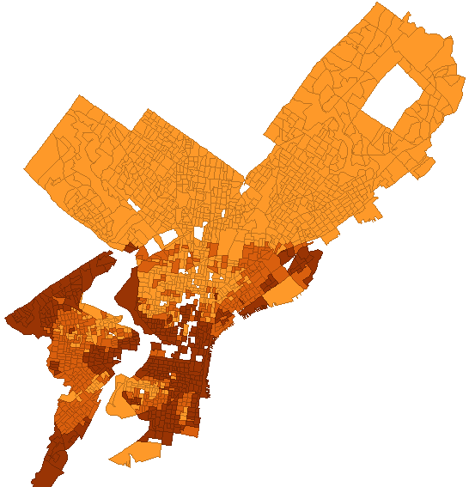
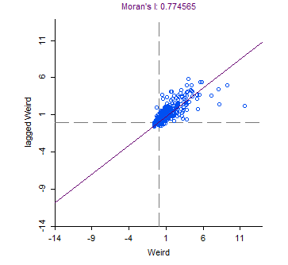
Weird Patterns Cont’d

Slide 33
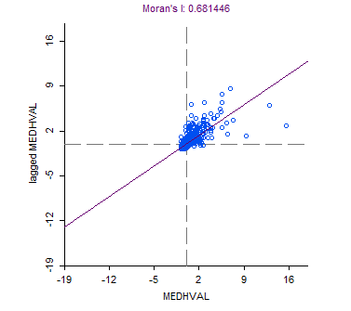
Moran’s Scatterplot
Weight matrix: Queen
X-axis: Median Household Income
Y-axis: Lagged Median Household Income
(for any block group i, lagged median household income is the average of median household income in all block groups that are queen neighbors of i)

Slide 34

Geary’s C (Contiguity) Ratio
Calculation is similar to Moran’s I,
For Moran, the cross-product is based on the deviations from the mean for the two location values
For Geary, the cross-product uses the actual values themselves at each location
Geary’s C varies on a scale from 0 to 2
C of approximately 1 indicates no autocorrelation/random
C of 0 indicates perfect positive autocorrelation/clustered
C of 2 indicates perfect negative autocorrelation/dispersed
Can convert to a -/+1 scale by: calculating C* = 1 - C
Moran’s I is usually preferred over Geary’s C
Note: Slide shamelessly stolen from Dr. Ron Briggs (UT Dallas)

Slide 35
Issues with Spatial Analysis
Modifiable areal unit problem (MAUP)
Results may depend on the areal unit used
Census tracts versus counties (scale issue)
Census tracts versus zip codes (not a scale issue)
Gerrymandering:
https://www.washingtonpost.com/news/wonk/wp/2016/01/13/this-is-actually-what-america-would-look-like-without-gerrymandering/?utm_term=.5838f20a39ff
Ecological fallacy
Results obtained from aggregated data (e.g. census tracts) cannot be assumed to apply to individual people
A special case of the MAUP problem
Encountered in spatial and non-spatial analysis
Nonuniformity of space and edge issues
Phenomena are not distributed evenly in space
Bank robberies cluster because they can only happen at banks!
Edges beyond which there are no data can significantly affect results (think weights for tracts along the border!)
Note: Slide edited from a presentation by Dr. Ron Briggs (UT Dallas)
See also: Chapter 2, O’Sullivan & Unwin

Slide 36
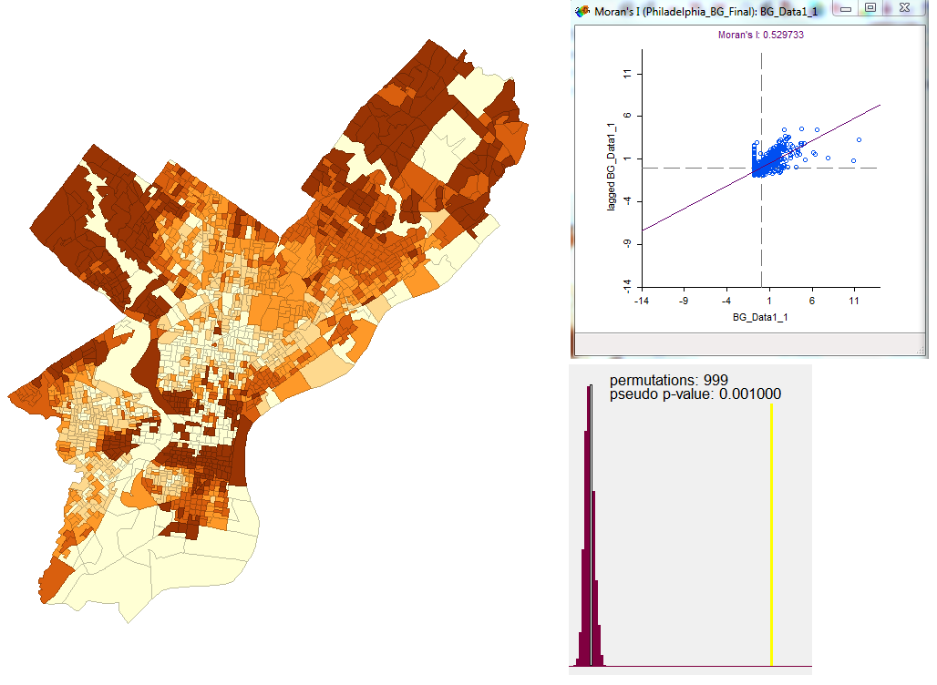
A Closer Look at MAUP
Median House Sale Price in Philadelphia, 2007. Block Group Level Data.
Queen Weight Matrix Used
Data Source:
Cartographic Modeling Lab

Slide 37
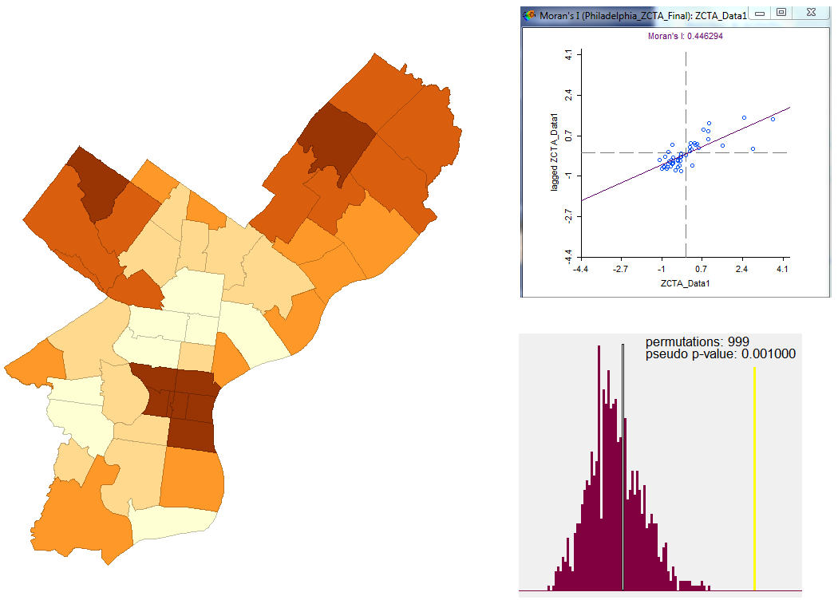
A Closer Look at MAUP (Cont’d)
Median House Sale Price in Philadelphia, 2007. Zip Code Tabulation Area Level Data.
Queen Weight Matrix Used
Data Source:
Cartographic Modeling Lab

Slide 38
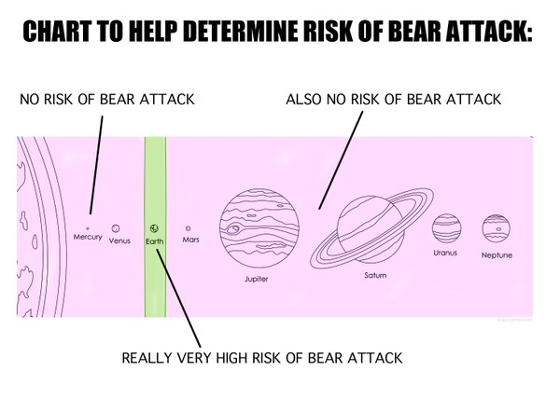
Source: http://i.imgur.com/mb49uP9.jpg

Slide 39
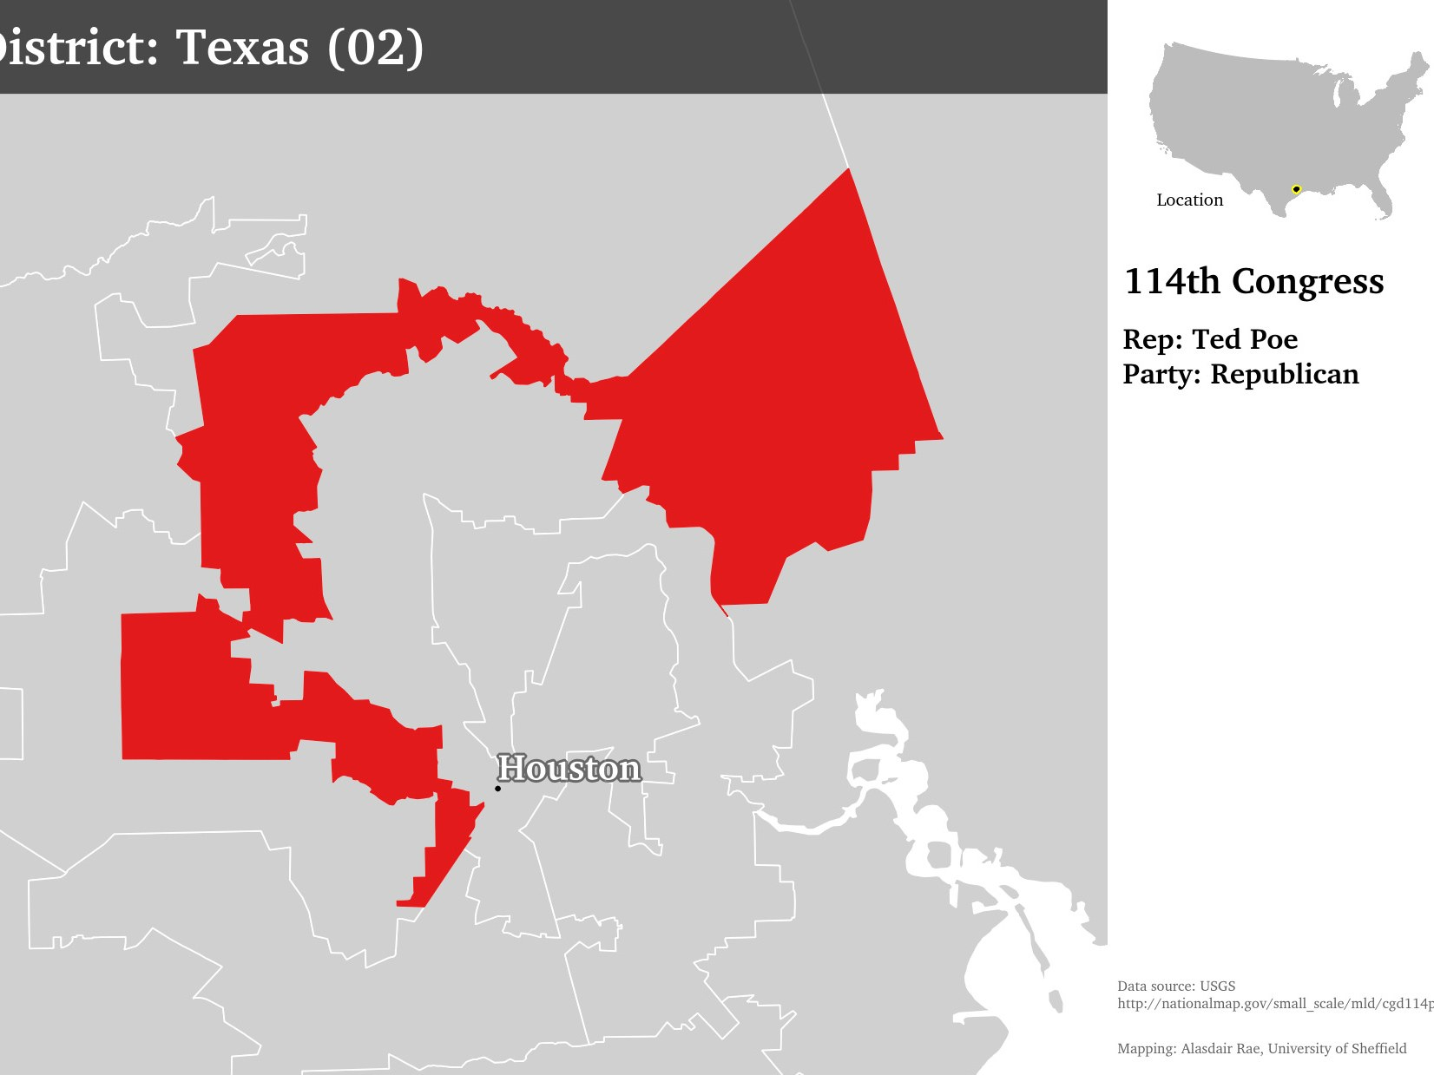
A Closer Look at Gerrymandering

Slide 40
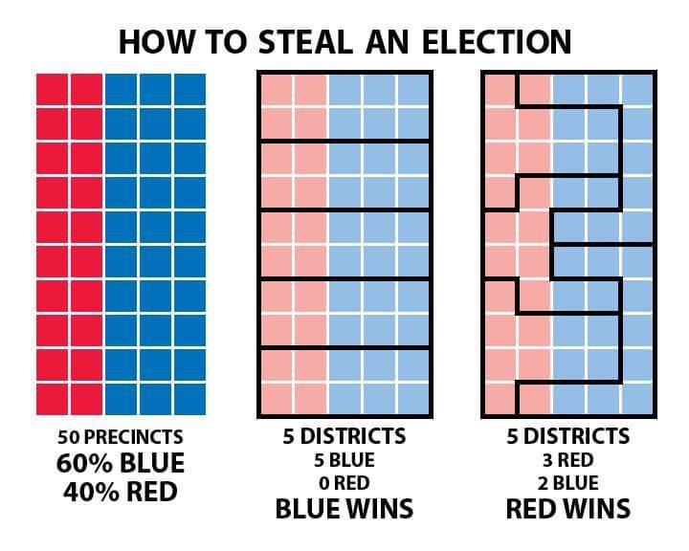
Source: https://twitter.com/cdncarto/status/571719993647222785

Slide 41
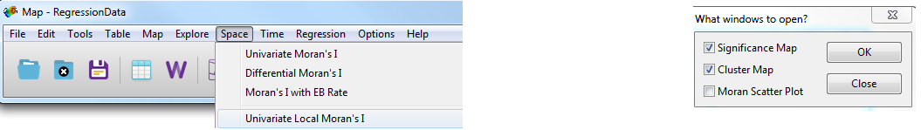
LISA (Local Indices of Spatial Autocorrelation)
Developed by Luc Anselin (creator of GeoDa)
Local indices of Spatial Autocorrelation:
To what extent are values at sites in vicinity of i associated with i ?
In GeoDa…
Select Variable

Slide 42
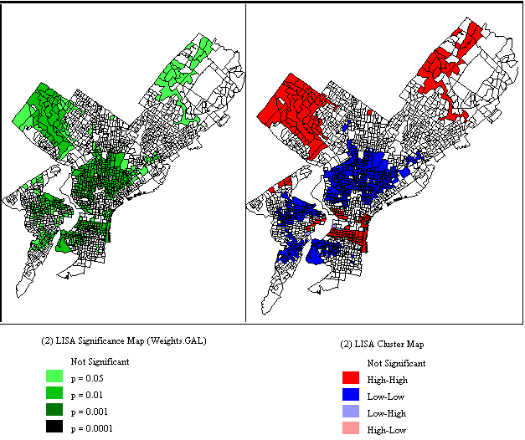
LISA Significance & Cluster Maps

Slide 43
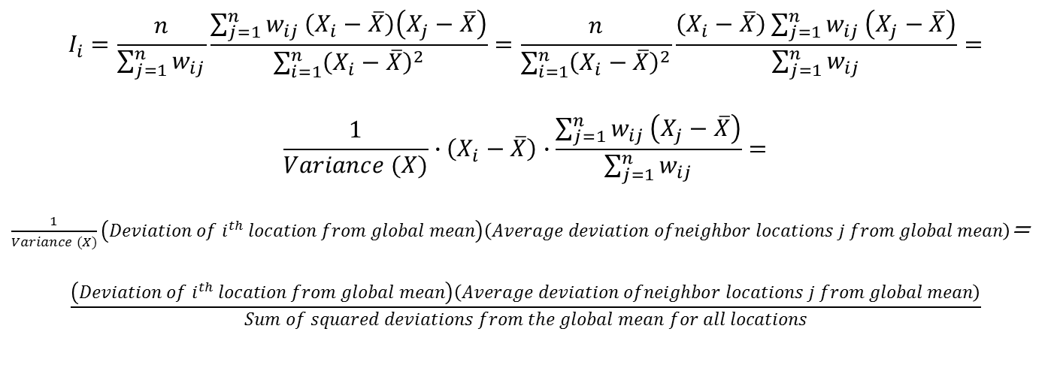
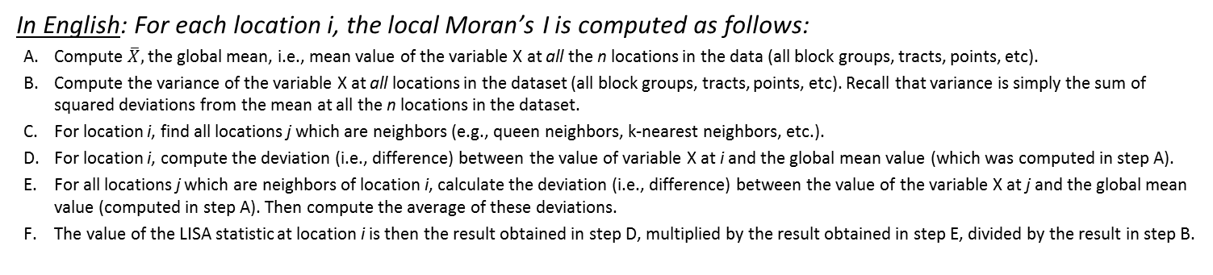
A Bit More about LISA Statistics
Compute the value of the Local Moran’s I at location i using the following formula:
$$I_{i}=\frac{n}{\sum_{j=1}^{n}{w_{ij}}}\frac{\sum_{j=1}^{n}{w_{ij}}\left(X_{i}−\overline{X}\right)\left(X_{j}−\overline{X}\right)}{\sum_{i=1}^{n}{{\left(X_{i}−\overline{X}\right)}^{2}}}=\frac{n}{\sum_{i=1}^{n}{{\left(X_{i}−\overline{X}\right)}^{2}}}\frac{\left(X_{i}−\overline{X}\right)\sum_{j=1}^{n}{w_{ij}}\left(X_{j}−\overline{X}\right)}{\sum_{j=1}^{n}{w_{ij}}}=$$
$$\frac{1}{Variance (X)}∙\left(X_{i}−\overline{X}\right)∙\frac{\sum_{j=1}^{n}{w_{ij}}\left(X_{j}−\overline{X}\right)}{\sum_{j=1}^{n}{w_{ij}}}=$$
$\frac{1}{Variance (X)}\left(Deviation of i^{th} location from global mean\right)\left(Average deviation ofneighbor locations j from global mean\right)$=
$$\frac{\left(Deviation of i^{th} location from global mean\right)\left(Average deviation ofneighbor locations j from global mean\right)}{Sum of squared deviations from the global mean for all locations}$$
In English: For each location i, the local Moran’s I is computed as follows:
Compute $\overline{X},$the global mean, i.e., mean value of the variable X at all the n locations in the data (all block groups, tracts, points, etc).
Compute the variance of the variable X at all locations in the dataset (all block groups, tracts, points, etc). Recall that variance is simply the sum of squared deviations from the mean at all the n locations in the dataset.
For location i, find all locations j which are neighbors (e.g., queen neighbors, k-nearest neighbors, etc.).
For location i, compute the deviation (i.e., difference) between the value of variable X at i and the global mean value (which was computed in step A).
For all locations j which are neighbors of location i, calculate the deviation (i.e., difference) between the value of the variable X at j and the global mean value (computed in step A). Then compute the average of these deviations.
The value of the LISA statistic at location i is then the result obtained in step D, multiplied by the result obtained in step E, divided by the result in step B.
Source: Luc Anselin. Local Indicators of Spatial Association-LISA, Geographical Analysis, Vol. 27, No. 2 (April 1995)

Slide 44
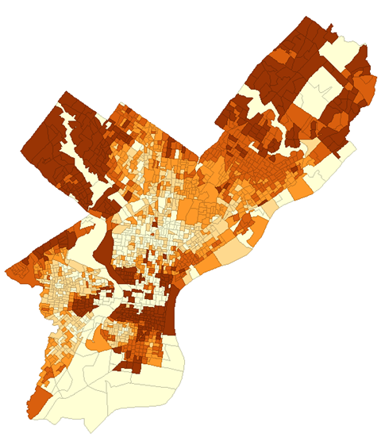
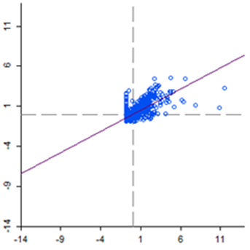
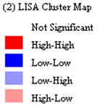
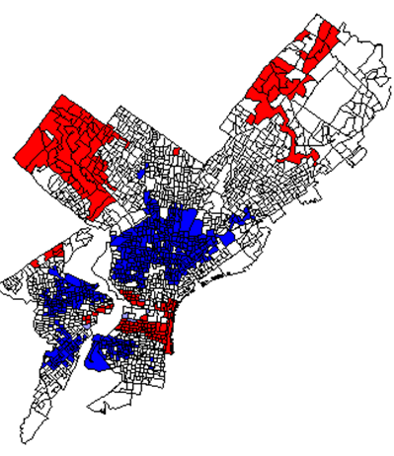
Original Map of X
(Median House Value)
Putting it All Together…
Global Moran’s I: 0.529
Low Xi & High Xj
- SA
High Xi & High Xj
+ SA*
* SA stands for
Spatial Autocorrelation
Xj-Axis:
Median House Value in Nearby Block Groups
Low Xi & Low Xj
+ SA
High Xi & Low Xj
- SA
Xi-Axis:
Median House Value in Block Group
Local Moran’s I | Deviation of the i^{th} location from the global mean (as computed on earlier slide; Step D) | Average deviation of neighbor locations j from the global mean (as computed on earlier slide; Step E)
+ (Similar to Neighbors) | + | +
+ (Similar to Neighbors) | - | -
- (Different from Neighbors) | + | -
- (Different from Neighbors) | - | +

Slide 45
Statistical Significance Testing
Recall that local Moran’s I is a measure of similarity to nearby observations
Local LISA statistic (i.e., local Moran’s I) may be positive or negative at location i. But is it positive or negative enough to be statistically significantly different from (approximately) 0? That is, is there statistically significant spatial autocorrelation (SA) at location i?
H0: No (local) spatial autocorrelation at location i (Ii ≈ 0)
Ii stands for Moran’s I at location i.
That is, there is no association between values of our variable at location i and its neighbors j
Ha: Positive or negative spatial autocorrelation at location i (Ii ≠ 0)
That is, values of our variable at location i are very similar to (+ SA) or starkly different from (- SA) from the values of that variable at nearby locations j
For local statistics, significance testing is generally conducted using permutations (or ‘‘reshufflings’’) of the values of variable X among the locations (block groups) in the data set, with the value at location of interest (location i) being held constant (not shuffled).
The rest of the process is the same as for the global Moran’s I statistic. These reshufflings can be carried out 9, 99 or 999 times, and for every random reshuffling, the value of Ii is calculated for each location.
The value of Ii for the original dataset is ranked relative to the list of the values produced by the reshufflings. When values of the Ii for the original dataset are very low or very high relative to the list of results produced by the shuffling procedure, they are considered to be of interest.
A pseudosignificance value can be determined by noting the rank of the actual value of Ii relative to the permuted results. For example, if the local statistic of the original pattern is the 97th highest recorded among 999 permutations, then it is estimated to be a 97 in 1000 occurrence with a pseudosignificance of p ~ 0.097.
Source: O’Sullivan & Unwin, Chapter 8

Slide 46
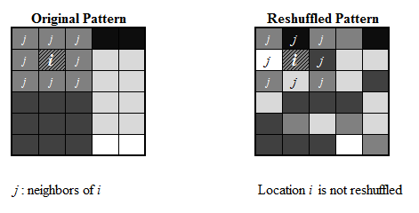
Illustration (for Queen Weights)
Moran’s I at location i tells us the extent to which the value of the variable at location i is associated with values of the variable at its neighbors j.
We compare these associations (i.e., values of the LISA index) for the original and reshuffled patterns to come up with a pseudo p-values.
Here, when we reshuffle the patterns, we don’t reshuffle the value of the variable at location i (unlike with global Moran’s I)
How much more similar/dissimilar are you to your neighbors than randomly selected observations?
Positive local spatial autocorrelation tells us of clustering of similar values near location i
Negative local spatial autocorrelation tells us that location i is a spatial outlier. For instance, it might be an area on the border between areas of affluence and poverty.

